Slide 1
Capstone Project-1
EDA On Hotel Booking Analysis​
​
BY​:
Team Name – SRP
Team Member :
Shrikant Mahalle(Team Leader)
Rohit Thakare
(Cohort Berlin)

Slide 2
Problem Statement:
For this project we will be analyzing Hotel Booking data. This data set contains booking information for a city hotel and a resort hotel, and includes information such as when the booking was made, length of stay, the number of adults, children, and/or babies, and the number of available parking spaces.
Hotel industry is a very volatile industry and the bookings depends on above factors and many more.
The main objective behind this project is to explore and analyze data to discover important factors that govern the bookings and give insights to hotel management ,which can perform various campaigns to boost the business and performance.

Slide 3
EDA will be divided into following 3 analysis. 1) Univariate analysis: Univariate analysis is the simplest of the three analyses where the data you are analyzing is only one variable. 2) Bivariate analysis: Bivariate analysis is where you are comparing two variables to study their relationships. 3) Multivariate analysis: Multivariate analysis is similar to Bivariate analysis but you are comparing more than two variables.
Work Flow :
So we will divide our work flow into following 3 steps.
Data Collection and Understanding
Data Cleaning and Manipulation
Exploratory Data Analysis(EDA)

Slide 4
Data Collection Understanding :
After collecting data it’s very important to understand your data. So we had hotel Booking analysis data. Which had 119390 rows and 32 columns. So let’s understand this 32 columns.
Data Description:
hotel :Resort Hotel or City Hotel
is_canceled : Value indicating if the booking was canceled (1) or not (0)
lead_time : Number of days that elapsed between the entering date of the booking and the arrival date
arrival_date_year : Year of arrival date
arrival_date_month : Month of arrival date
arrival_date_week_number : Week number of year for arrival date
arrival_date_day_of_month : Day of arrival date
stays_in_weekend_nights : Number of weekend nights
stays_in_week_nights : Number of week nights.
adults : Number of adults
children : Number of children babies : Number of babies
meal : Type of meal booked.
country : Country of origin.

Slide 5
Data Collection Understanding :
market_segment : Market segment designation. (TA/TO)
distribution_channel : Booking distribution channel.(T/A/TO)
is_repeated_guest : is a repeated guest (1) or not (0)
previous_cancellations : Number of previous bookings that were cancelled by the customer prior to the current booking
previous_bookings_not_canceled : Number of previous bookings not cancelled by the customer prior to the current booking
reserved_room_type : Code of room type reserved.
assigned_room_type : Code for the type of room assigned to the booking.
booking_changes : Number of changes made to the booking from the moment the booking was entered on the PMS until the moment of check-in or cancellation
deposit_type : No Deposit, Non Refund , Refundable.
agent : ID of the travel agency that made the booking company : ID of the company/entity that made the booking .
days_in_waiting_list : Number of days the booking was in the waiting list before it was confirmed to the customer

Slide 6
Data Collection Understanding :
customer_type : type of customer.
Contract,Group,transient,Transient party.
adr : Average Daily Rate as defined by dividing the sum of all lodging transactions by the total number of staying nights
Required_car_parking_spaces : number of car parking spaces required by the customer. Total_of_special_requests : number of special requests made by the customer (e.G. Twin bed or high floor)
Reservation_status : reservation last status.

Slide 7
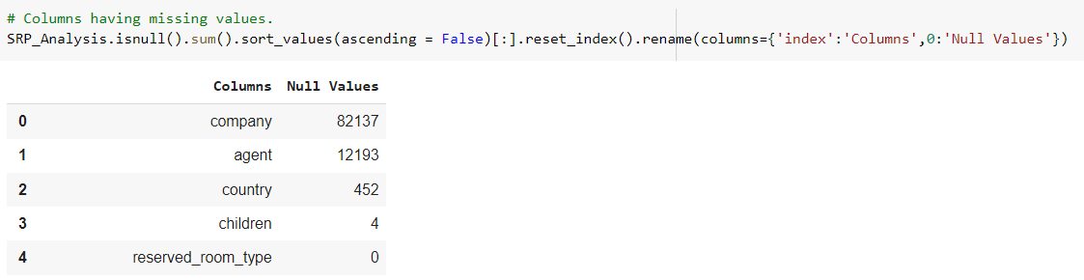
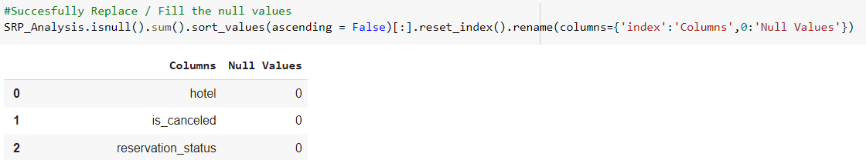
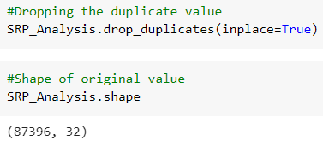
Data Cleaning and Manipulation:
There were 4 columns company, agent, country and children with missing values.
Handling Duplicates: Data had 31994 duplicates values. So we dropped it from the data.
Feature Engineering: We created 2 new columns 1)‘Total_People’ = from the Children, adults, babies.
2) ‘Total_stay’ = From weekend nights and weekdays

Slide 8
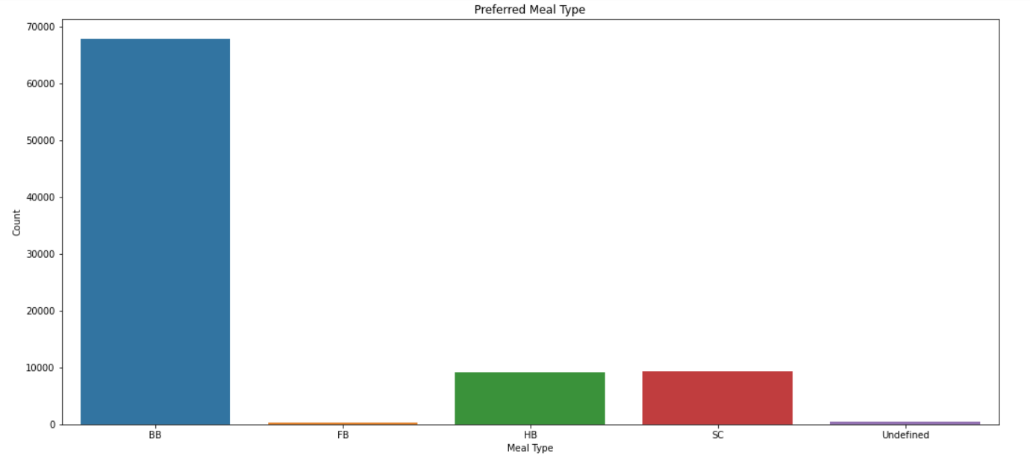
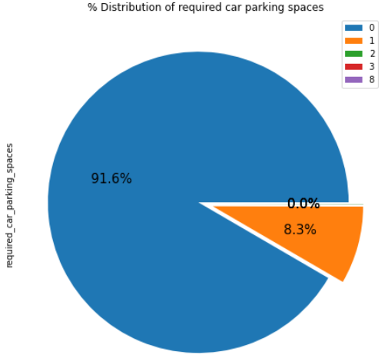
Exploratory Data Analysis (EDA) :
Conclusions:
City hotels are the most preferred hotel type by the guests. We can say City hotel is the busiest hotel.
BB( Bed & Breakfast) is the most preferred type of meal by the guests.

Slide 9
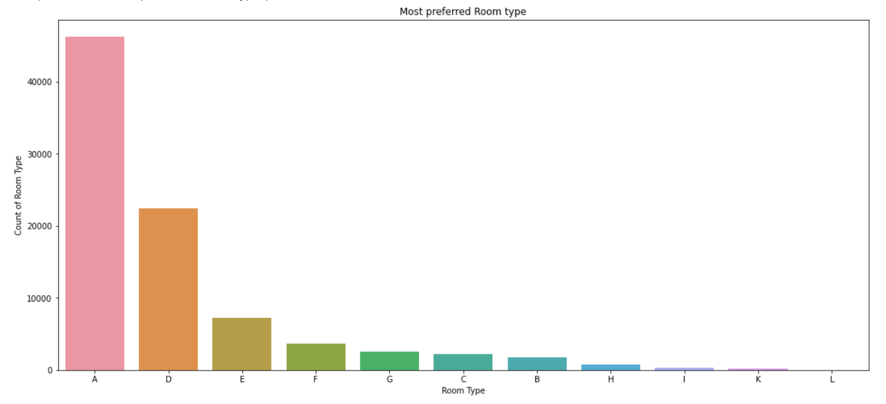
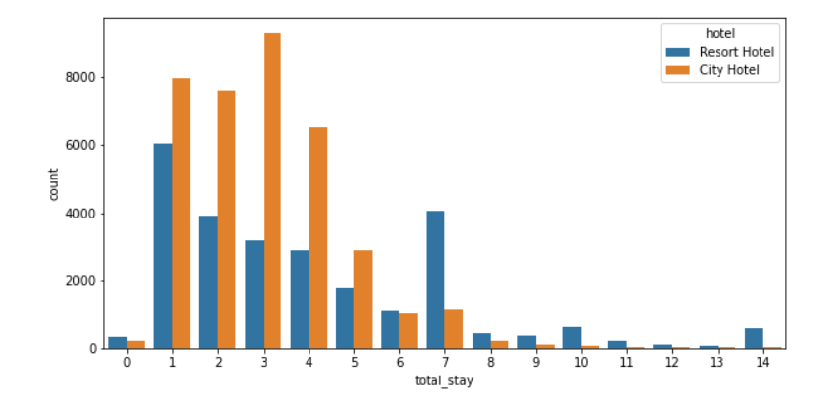
Exploratory Data Analysis (EDA) :
Conclusions:
Most demanded room type is A
Most common stay length is less than 4 days and generally people prefer City hotel for short stay, but for long stays, Resort Hotel is preferred.

Slide 10
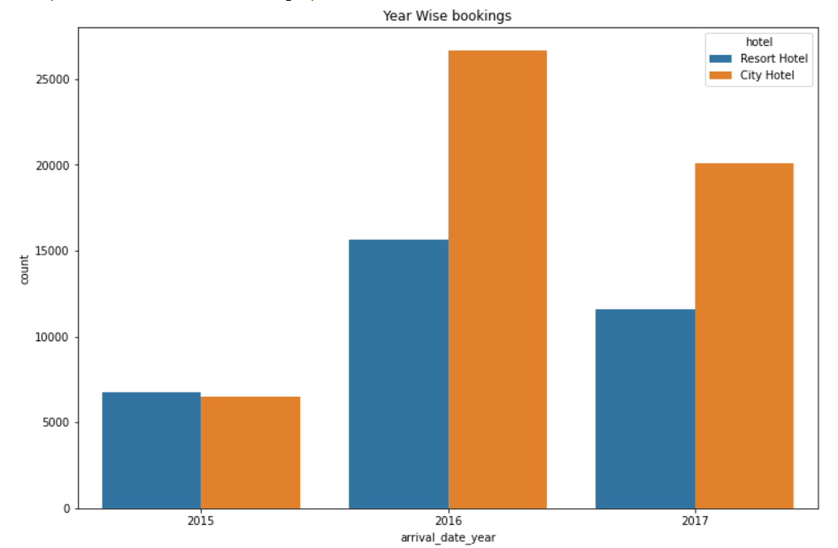
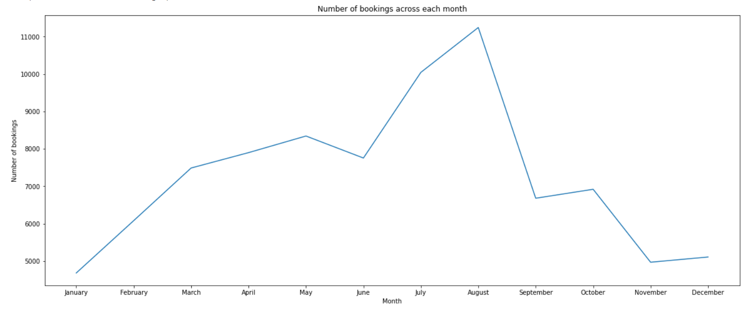
EXPLORATORY DATA ANALYSIS (EDA) :
Conclusions:
Most of the bookings for City hotels and Resort hotel were happened in 2016
Most number of guest comes in month of August.

Slide 11
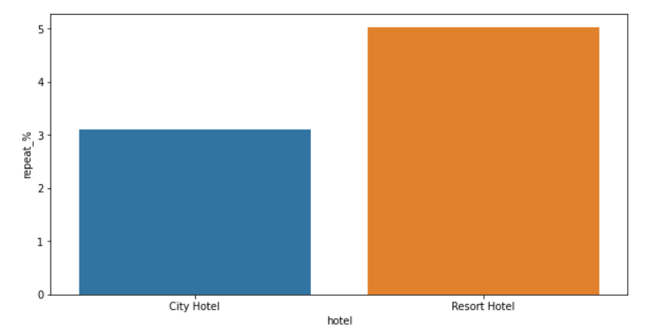
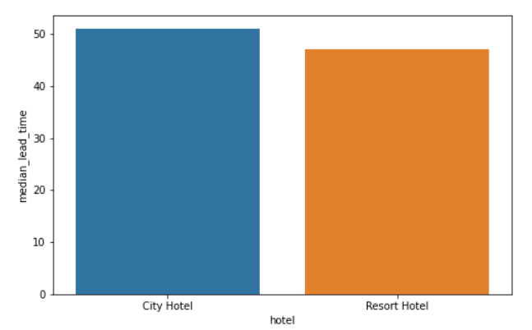
EXPLORATORY DATA ANALYSIS (EDA) :
Conclusions:
Both hotels have very small percentage that customer will repeat, but Resort hotel has slightly higher repeat % than City Hotel.
Conclusions:
City hotel has slightly higher median lead time. Also median lead time is significantly higher in each case, this means customers generally plan their hotel visits way to early.

Slide 12
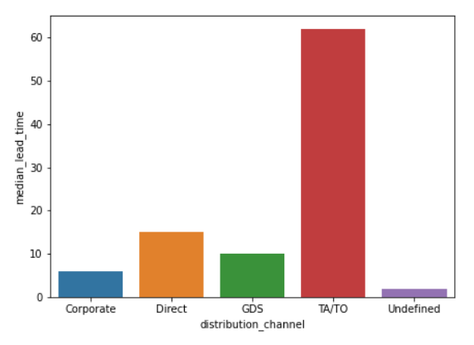
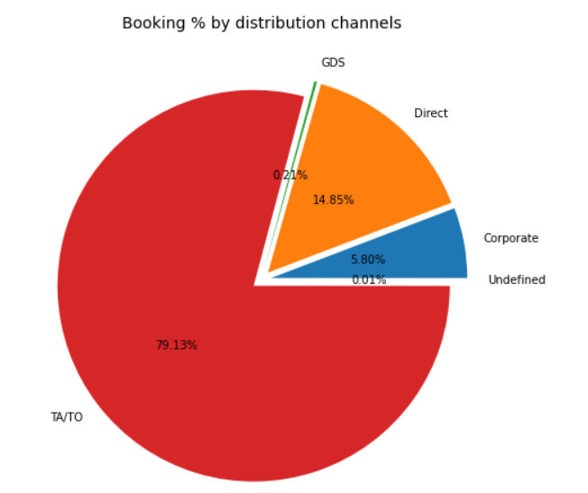
EXPLORATORY DATA ANALYSIS (EDA) :
Conclusions:
Most of the bookings were made through TA/TO (travel agents/Tour operators).
TA/TO most used distribution channel for booking almost 80%, followed by Direct then corporate then DGS and Undefined .

Slide 13
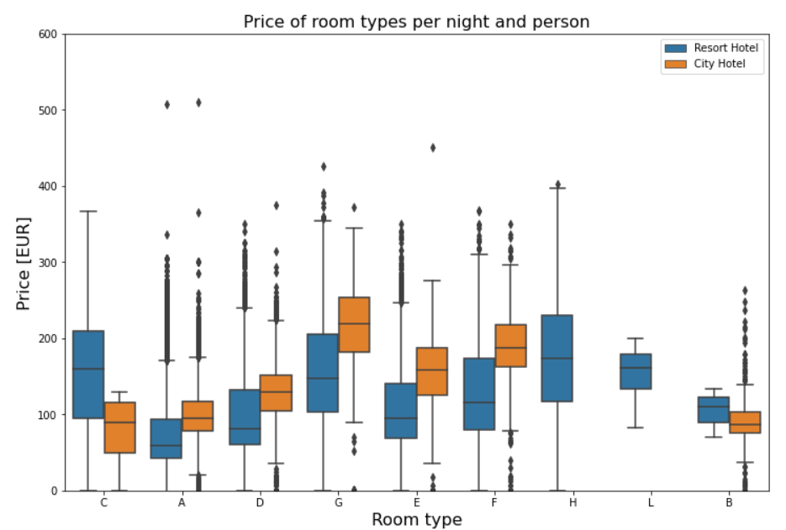
EXPLORATORY DATA ANALYSIS (EDA) :
Conclusions:
This figure shows the average price per room, depending on its type and the standard deviation. Note that due to data anonymization rooms with the same type letter may not necessarily be the same across hotels.

Slide 14
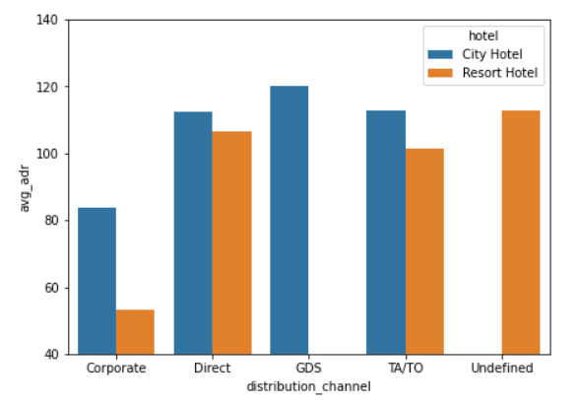
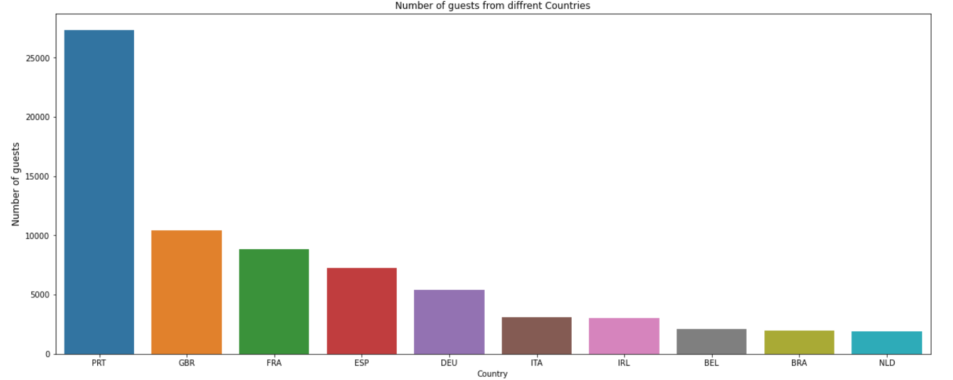
EXPLORATORY DATA ANALYSIS (EDA) :
Conclusions:
GDS channel brings higher revenue generating deals for City hotel, in contrast to that most bookings come via TA/TO. City Hotel can work to increase outreach on GDS channels to get more higher revenue generating deals.
Most guest are from Portugal and other European countries.

Slide 15
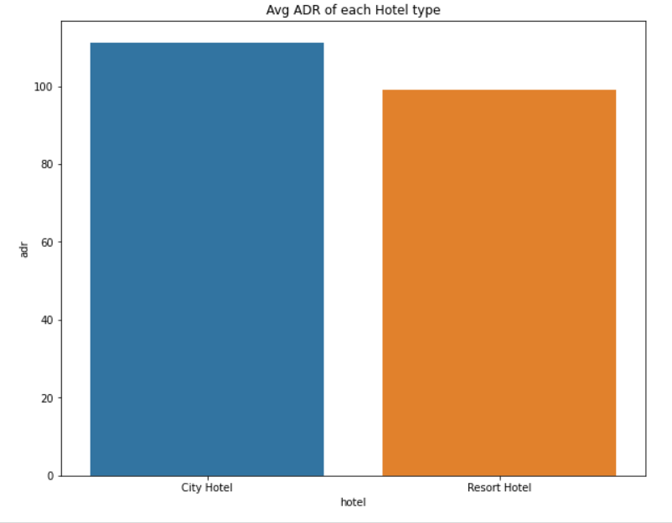
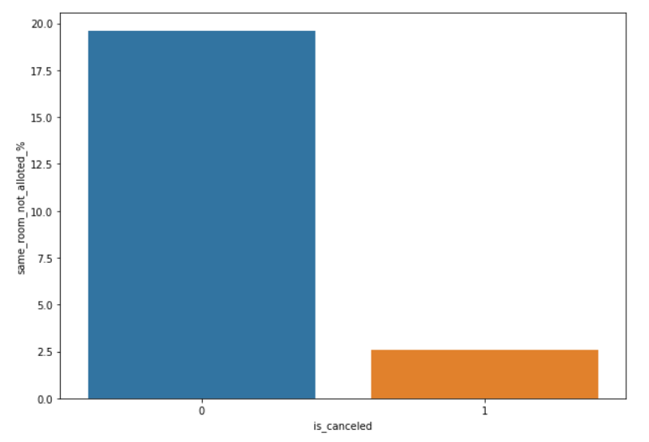
EXPLORATORY DATA ANALYSIS (EDA) :
Conclusions:
Average ADR for city hotel is high as compared to resort hotels. These City hotels are generating more revenue than the resort hotels.
We see that not getting same room as demanded is not the case of cancellation of rooms. A significant percentage of bookings are not cancelled even after getting different room as demanded.

Slide 16
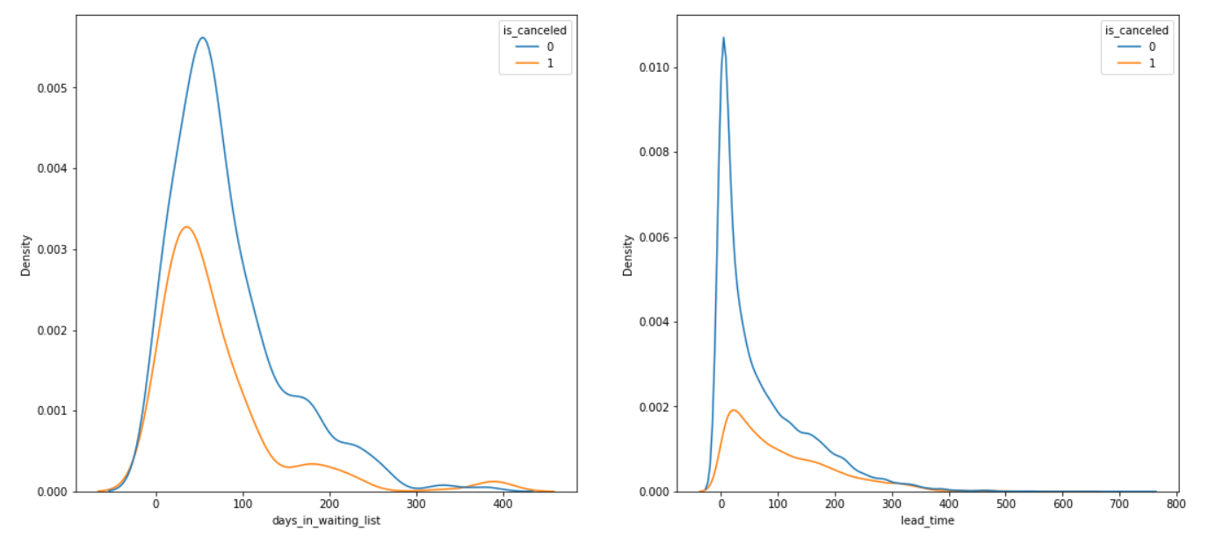
EXPLORATORY DATA ANALYSIS (EDA) :
Conclusions:
We see that most of the bookings that are cancelled have waiting period of less 150 days but also most of bookings that are not cancelled also have waiting period less than 150 days. Hence this shows that waiting period has no effect on cancellation of bookings. \ \ Also, lead time has no affect on cancellation of bookings, as both curves of cancelation and not cancelation are similar for lead time too

Slide 17
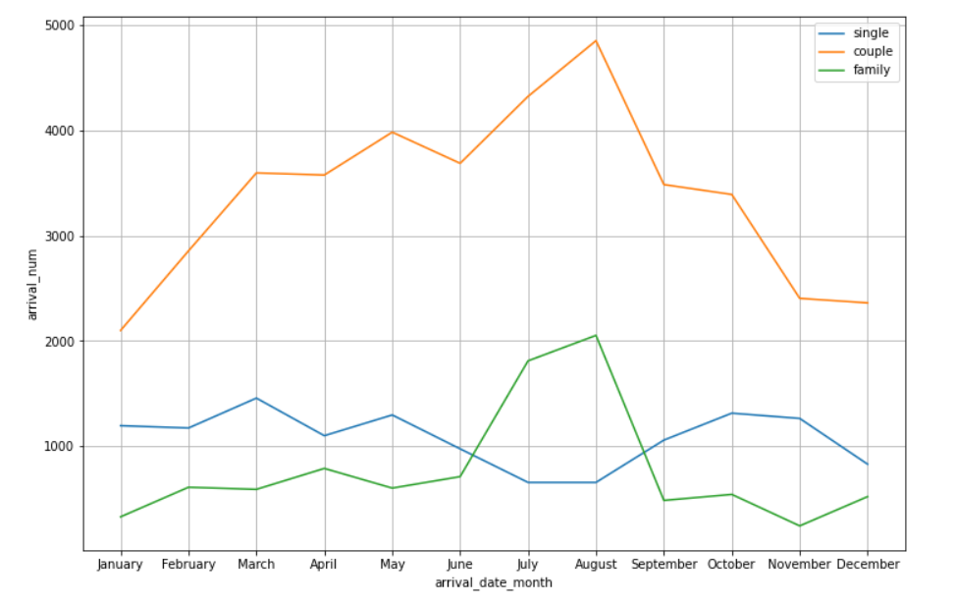
EXPLORATORY DATA ANALYSIS (EDA) :
Conclusions:
Moslty bookings are done by couples(although we are not sure that they are couple as data doesn't tell about that) It is clear from graph that their is a sudden surge in arrival num of couples and family in months of July and August. So better plans can be planned accordingly at that time for these type of customers.

Slide 18
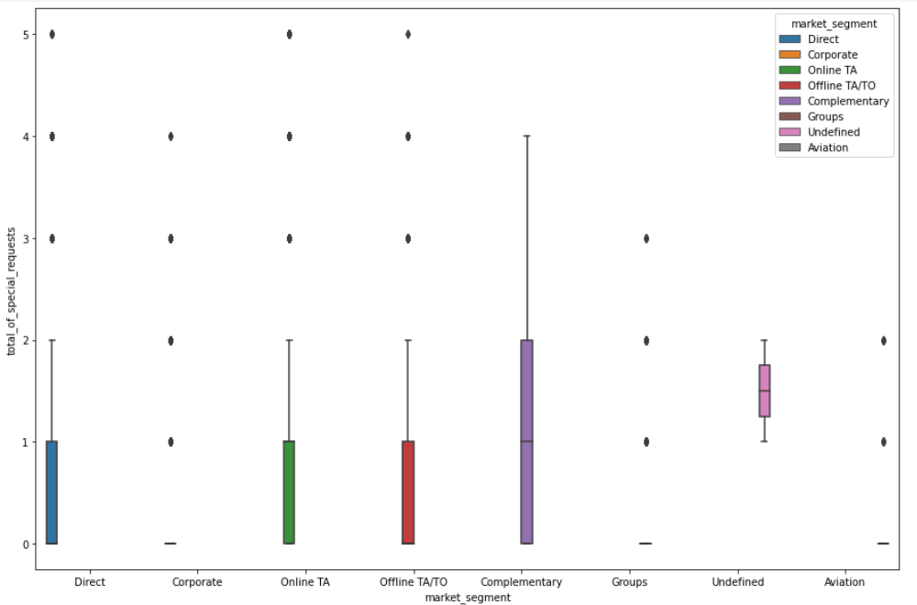
EXPLORATORY DATA ANALYSIS (EDA) :
Conclusions:
All of market segment mostly have special request.
91.6 % guests did not required the parking space. only 8.3 % guests required only 1 parking space

Slide 19

THANK YOU
Shrikant Mahalle
shrikantmahalle41@gmail.com
Mo.no:9823568542
Rohit Thakare
rohitthakare0721@gmail.com
Mo.no: 7620540848

